Slide 1
DATA STRUCTURES & ALGORITHMS

Slide 2
CONTENTS
What is Big O ?
Rules of Big O.
Stack.

Slide 3
01
What is Big O ?

Slide 4
What is Big O ?
It is the formal way to express the upper bound of an algorithm’s running time.
Upper bound means for give input this notation determines longest amount of time an algorithm can take to complete.

Slide 5
02
Rules of Big O.

Slide 6
Rules of Big O.
It is a single processor.
It performs sequential execution of statements.
Assignment operation takes one unit of time.
Return statement takes one unit of time.
Arithmetic operation takes one unit of time.
Logical operators takes 1 unit of time.
Other small/single operations take 1 unit of time.
Drop lower order terms.
Drop constant multipliers.
EX: T = 2n² + 3n + 1 = O(n²)
Find Big O for the following Examples.

Slide 7
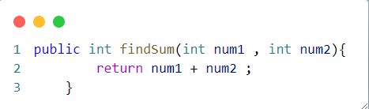
EX_1
.
Unit time | Operation | Line no.

Slide 8
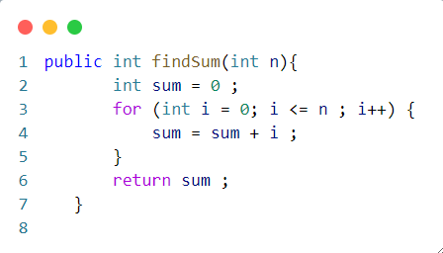
EX_2
.
Unit time | Operation | Line no.

Slide 9
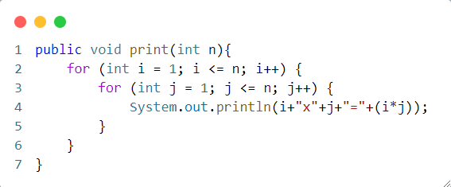
EX_3
.
Unit time | Operation | Line no.

Slide 10
03
Stack.

Slide 11
Stack
A stack is a linear data structure that follows the Last-In-First-Out (LIFO) principle. It behaves like a stack of plates, where the last plate added is the first one to be removed.

Slide 12
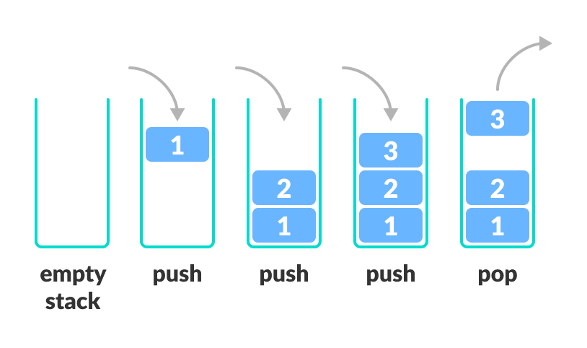
Stack

Slide 13
Stack Operations
Key Operations on Stack Data Structures
  Push: Adds an element to the top of the stack.
  Pop: Removes the top element from the stack.
  Peek: Returns the top element without removing it.
  IsEmpty: Checks if the stack is empty.
  IsFull: Checks if the stack is full (in case of fixed-size arrays).

Slide 14
THANKS
Eng. Khaled Al-arashi

